Slide 1
Analysis of Glassdoor Reviews for competitors – ICE ( Intercontinental Exchange)

Slide 2
Agenda
Executive Summary

Slide 3
Executive Summary
Objectives
Scrapping Glassdoor reviews for competitors given by their employees.
Analyzing reviews of competitors
Identify hidden patterns in data about employee engagement.
Key Observations
We scrapped close to 90% of reviews.
Total 310 reviews were analyzed.

Slide 4
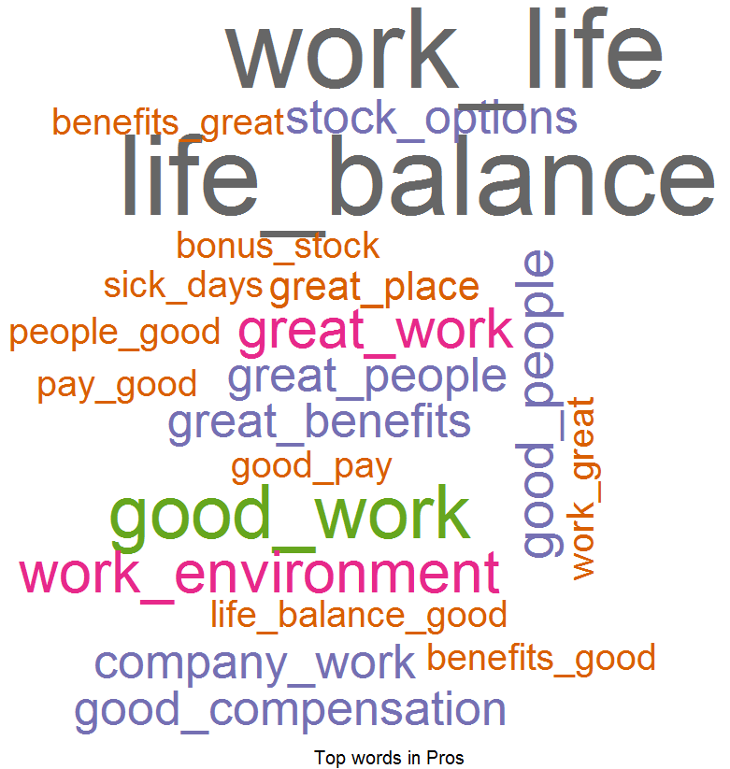
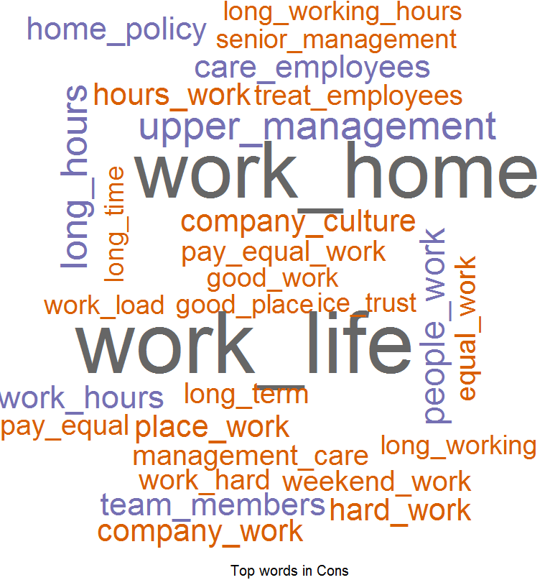
Overall Word Cloud for Pros and Cons
Word Cloud for Pros
Word Cloud for Cons
Good Words List –
Work life balance
Good benefits
Good work
Fast passed work environment
Good people
Stock options
Word List which people don’t like –
Work life balance
Work from home policy
Upper management
Long hours
Working hours
Career growth
Care for employees
Hard work

